Slide 1

W4111 – 02: Introduction to Databases
Lecture 6: ER Modeling, SQL, Relational (Part 5)
Donald F. Ferguson dff9@Columbia.edu
TRANSCENDING DISCIPLINES, TRANSFORMING LIVES

Slide 2

We will start in a a couple of minutes.
2 | W4111_02_F20: Introduction to Databases -- Lecture 6

Slide 3
Today’s Agenda
3 | W4111_02_F20: Introduction to Databases – Lecture 6

Slide 4
Today’s Agenda
Questions/answers.
Course schedule and assignments.
Course schedule as we know it.
Continuing Module I – ER Models, Relational Algebra, SQL
SQL:
Some miscellaneous concepts: Recursion, domains, types, ... ...
Quick look at indexes.
Functions, procedures, triggers, ... ...
Authorization.
Entity-Relationship Modeling:
Weak Entity Sets
Inheritance
Some worked examples.
4 | W4111_02_F20: Introduction to Databases – Lecture 6

Slide 5
Questions, Answers, Discussion
5 | W4111_02_F20: Introduction to Databases -- Lecture 6
Notes:
bb

Slide 6
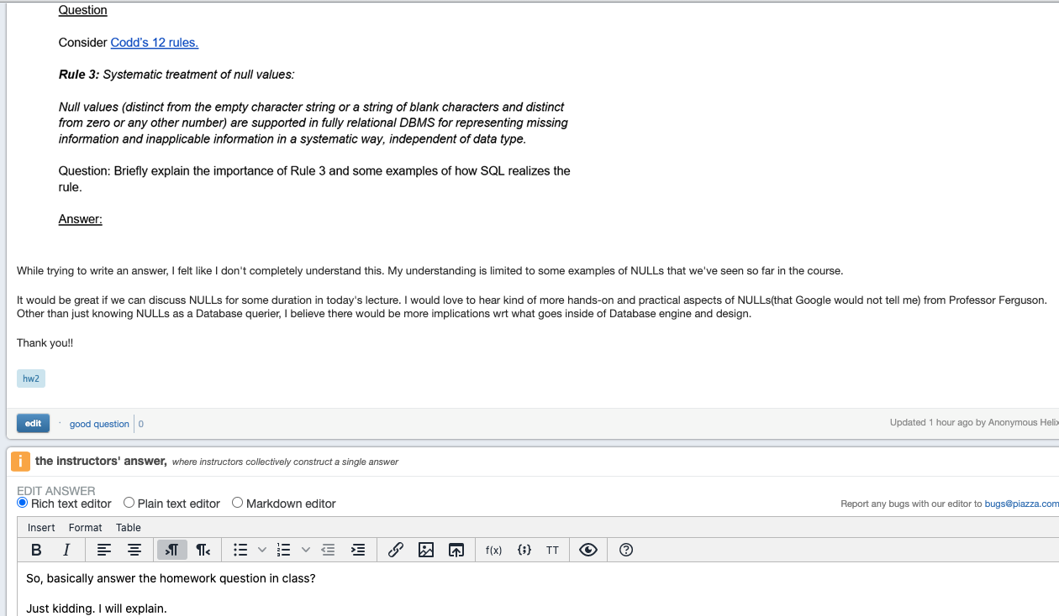
NULL
6 | W4111_02_F20: Introduction to Databases – Lecture 6

Slide 7
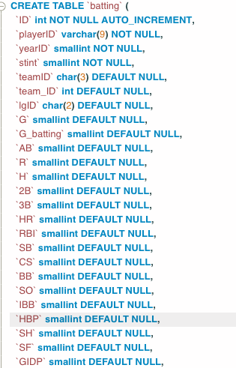
NULL
Sometimes a (row, column) value is unknown or not applicable.
NULL indicates this fact in a way that is independent of the column’s type.
Some people do not have middle initials. What is the symbol: “-”, “”, “0”, ...?
What is the value for a date if unknown: 0000-00-00, 9999-12-31, ...?
What is the value for unknown for an account balance? 0, -1, ... are valid values in some domains and scenarios.
To know which value indicates not applicable or unknown would require understanding all domains and carefully writing SQL. SELECT * FROM batting NATURAL JOIN people where dateOfBirth = “0000-00-00” or AB = -1 or stint=‘X’;
I am a baseball expert, and I know that -1 is not valid for H, AB. Consider group by:
SELECT playerid, sum(H) FROM batting GROUP BY playerID;
I need 1) Know that some rows have unknown values. 2) -1 is the value. 3) Handle in very query.
AVG (2, 3, -1, 0) = 1. AVG(2, 3, NULL, 0) = 5/3.
RDBMS support auto-generated columns, like DATETIME DOB generation. Is
INSERT INTO people(playerID, 2, 0, 1960) indicating incomplete knowledge,
Or is there a bug in the program?
7 | W4111_02_F20: Introduction to Databases – Lecture 6

Slide 8
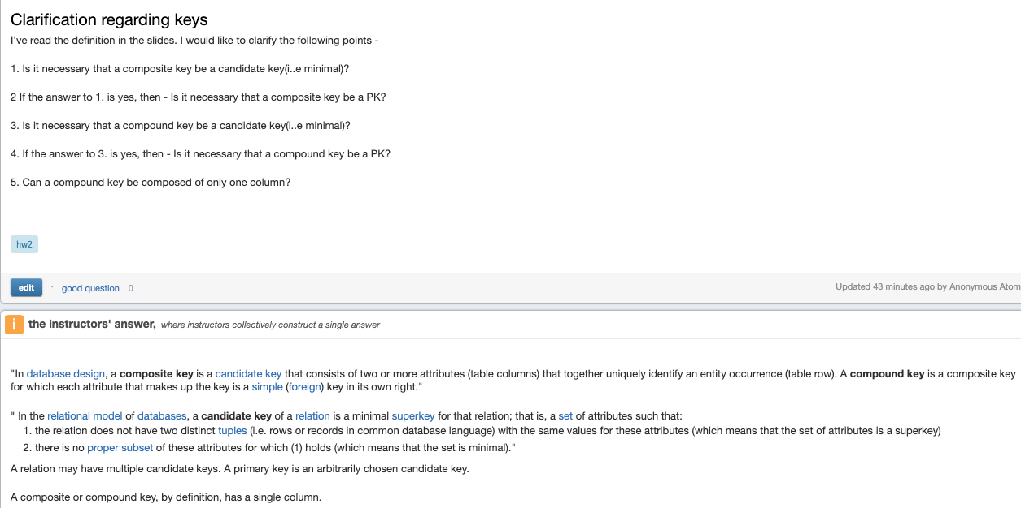
Keys (or “DB professors can make anything baffling”)
(diagnosis_type, comment, date)
(DSM4_NO, diagnosis_code, comment, date)
Dff9 yy5
8 | W4111_02_F20: Introduction to Databases – Lecture 6

Slide 9
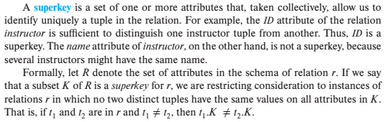
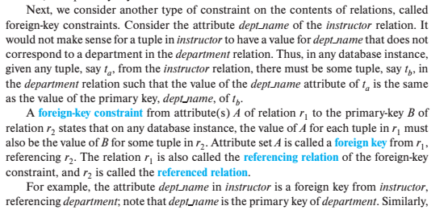
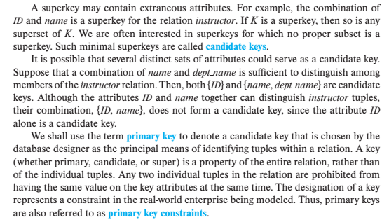
Keys – From the Textbook
Some Keys
Super Key
Candidate Key
Primary Key
Foreign Key
Secondary Key/Alternative Key
Simple Key
Composite Key
Compound Key
Unique Key
Foreign Key
Natural Key
Substitute Key
Surrogate Key
External Key
Ferguson Key
9 | W4111_02_F20: Introduction to Databases – Lecture 6

Slide 10
Keys – From the Textbook
Also, which context are you using?
Relation Model
SQL
A specific database representation of SQL
Terminology relative to a NoSQL database
Common, imprecise usage
... ...
Ferguson Key: A key definition so baffling complex and arbitrary that you will stop asking about keys to avoid hearing me define it yet again.
Some Keys
Super Key
Candidate Key
Primary Key
Foreign Key
Secondary Key/Alternative Key
Simple Key
Composite Key
Compound Key
Unique Key
Foreign Key
Natural Key
Substitute Key
Surrogate Key
External Key
Ferguson Key
10 | W4111_02_F20: Introduction to Databases – Lecture 6

Slide 11
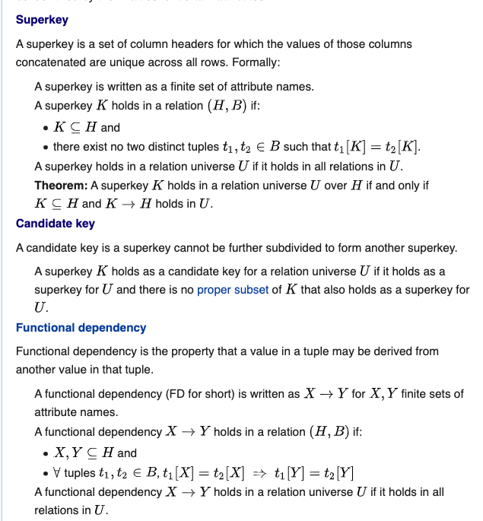
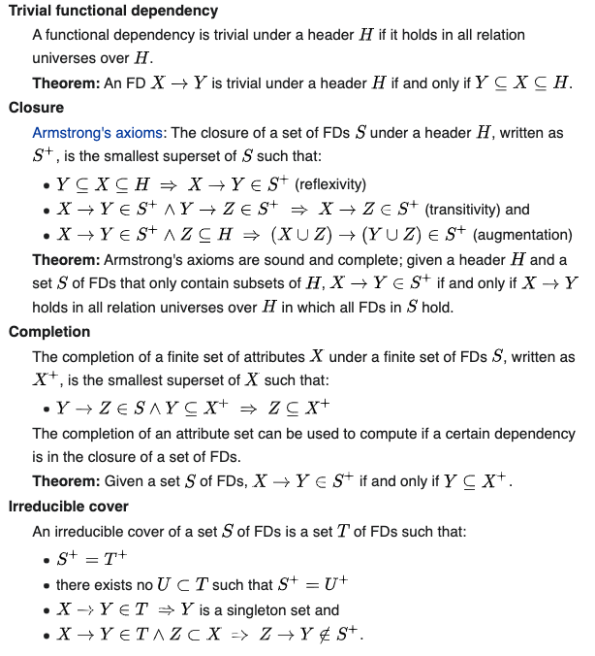
Thinking Too Much About Keys Leads to Sh*t Like This ... ...
11 | W4111_02_F20: Introduction to Databases – Lecture 6

Slide 12
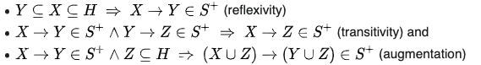
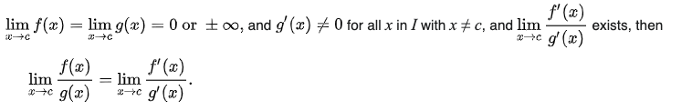
Thinking Too Much About Keys Leads to Sh*t Like This ... ...
If your team leader in your billion dollar start up asks you to design a good database schema for the application.
And you start saying things like ...
You will wind up unemployed, or in hospital.
Why do we cover these concepts? For the same reason you learn L'Hôpital's rule in Calculus I.
Does this come up in bridge design or financial modeling?
12 | W4111_02_F20: Introduction to Databases – Lecture 6

Slide 13
Thinking Too Much About Keys Leads to Sh*t Like This ... ...
Oh. And if someone asks you questions about these concepts, what do you do?
The same thing I did for L'Hôpital's rule.
LOOK IT UP.
If your team leader in your billion dollar start up asks you to design a good database schema for the application.
And you start saying things like ...
You will wind up unemployed, or in hospital.
Why do we cover these concepts? For the same reason you learn L'Hôpital's rule in Calculus I.
Does this come up in bridge design or financial modeling?
13 | W4111_02_F20: Introduction to Databases – Lecture 6

Slide 14
Course Schedule
14 | W4111_02_F20: Introduction to Databases -- Lecture 6
Notes:
bb

Slide 15
Tentative Course Schedule as We Know It So Far
We released homework 2.
There is a single, common homework homework for the programming and non-programming track.
We will resume having distinct HWs for the tracks for HW 3.
Midterm: Release date is 23-Oct and is due 30 Oct.
Homework 3: Released 30-Oct, due 13-Nov
Common track of written questions on Module II Concepts.
Separate implementation assignments for the two tracks.
Homework 4: Released 13-Nov, due 27-Nov.
Homework 5: Released 27-Nov, due 11-Dec.
Take home final exam: Released 11-Dec, due 18-Dec.
15 | W4111_02_F20: Introduction to Databases – Lecture 6

Slide 16
ER Model, Relation Model, SQL Continued
16 | W4111_02_F20: Introduction to Databases -- Lecture 6
Notes:
bb

Slide 17

Some Miscellaneous SQL
17 | W4111_02_F20: Introduction to Databases -- Lecture 6

Slide 18
Assertions
An assertion is a predicate expressing a condition that we wish the database always to satisfy.
The following constraints, can be expressed using assertions:
For each tuple in the student relation, the value of the attribute tot_cred must equal the sum of credits of courses that the student has completed successfully.
An instructor cannot teach in two different classrooms in a semester in the same time slot
An assertion in SQL takes the form:
create assertion <assertion-name> check (<predicate>);
Some RDBMS do not support assertions, including MySQL.
I may ask written questions on HW/exam but will not require you to use the concept.
Knowing about the concept is useful.

Slide 19
Web Server
Text Search Engine
(“Cat”, url1, url2, ....)
([“Cat”, “Dog”], url5, url5, ... ...)

Slide 20
Large-Object Types
Large objects (photos, videos, CAD files, etc.) are stored as a large object:
blob: binary large object -- object is a large collection of uninterpreted binary data (whose interpretation is left to an application outside of the database system)
clob: character large object -- object is a large collection of character data
When a query returns a large object, a pointer is returned rather than the large object itself.

Slide 21
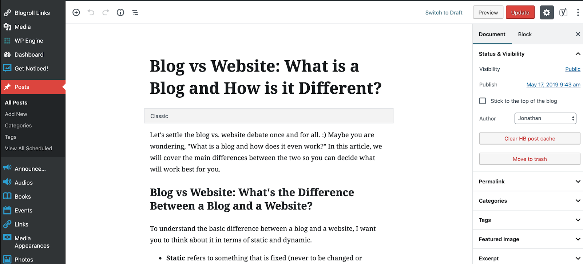
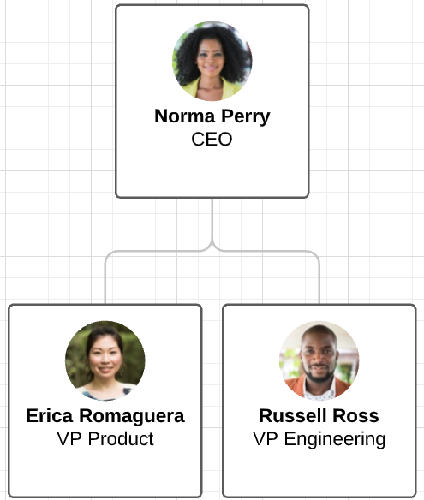
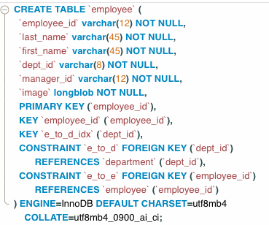
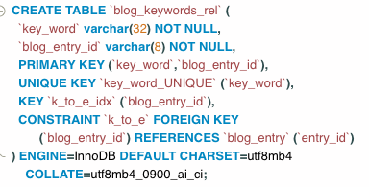
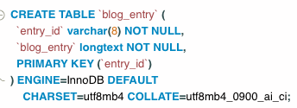
BLOB and CLOB
Categories
Key words
Note: This is not a great design
21 | W4111_02_F20: Introduction to Databases – Lecture 6

Slide 22
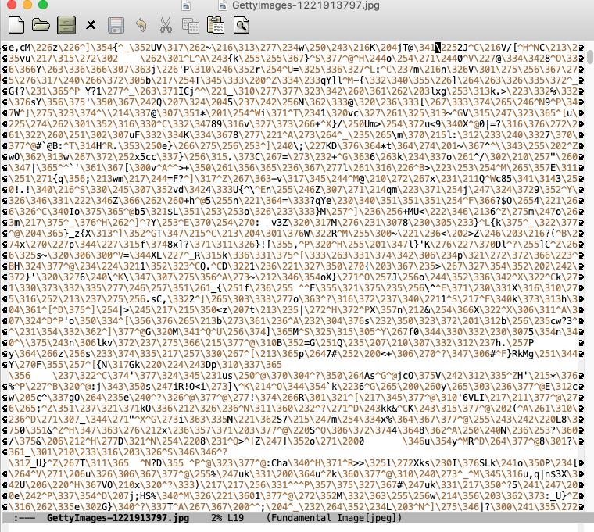

BLOB and CLOB
JPEG Formatted Image
https://en.wikipedia.org/wiki/JPEG
Underlying file data.
22 | W4111_02_F20: Introduction to Databases – Lecture 6

Slide 23
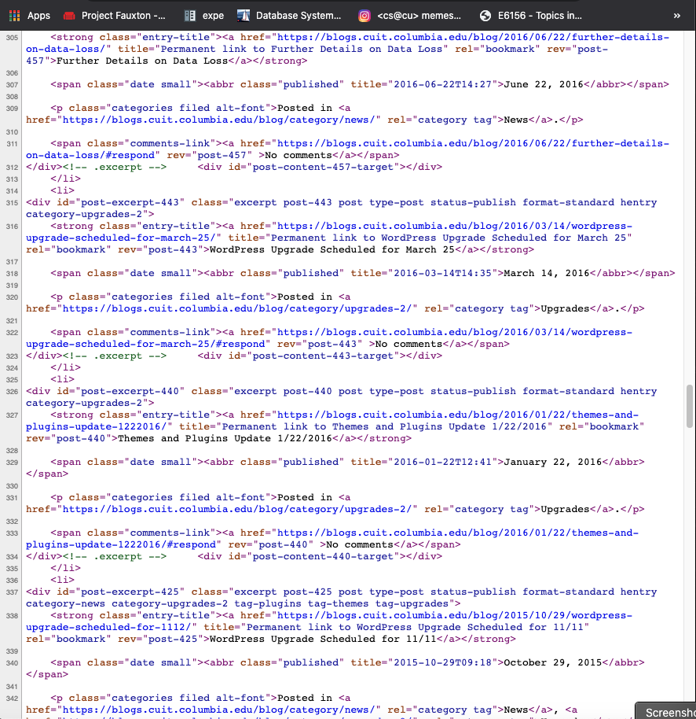
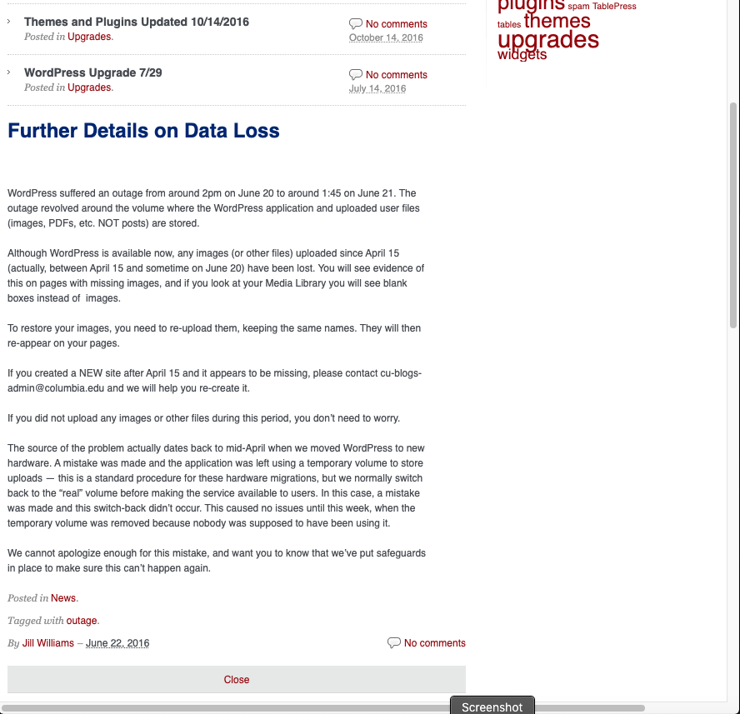
BLOB and CLOB
Underlying file data.
HTML Document
23 | W4111_02_F20: Introduction to Databases – Lecture 6

Slide 24
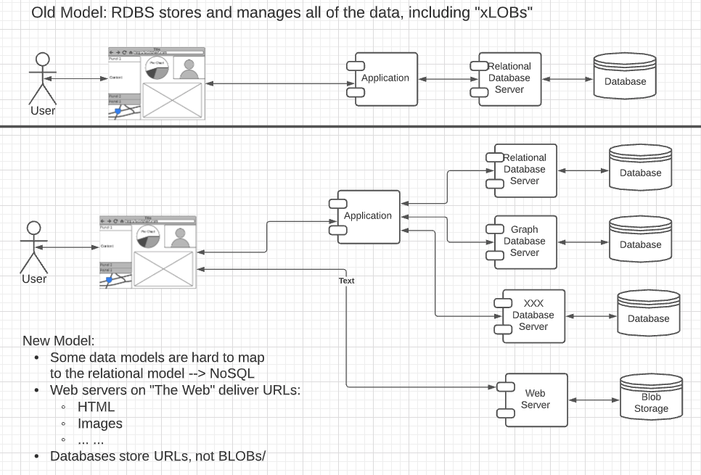
BLOB, CLOB and “The Web”
Application/DB Model
Has evolved from BLOBs in DBs
To URLs referencing “XLOB” in “object storage,” e.g.
Amazon S3
Azure BLOB Storage
Object in this sense is not the same as “Java” or other OO language ”object.”
Object is a way of saying, “Big Thing.”
The programming track will try to build, with my help, a simple application in this model.
24 | W4111_02_F20: Introduction to Databases – Lecture 6

Slide 25
User-Defined Types
create type construct in SQL creates user-defined type
create type Dollars as numeric (12,2) final
Example:
create table department (dept_name varchar (20), building varchar (15), budget Dollars);

Slide 26
Domains
create domain construct in SQL-92 creates user-defined domain types
create domain person_name char(20) not null
Types and domains are similar. Domains can have constraints, such as not null, specified on them.
Example:
create domain degree_level varchar(10) constraint degree_level_test check (value in ('Bachelors', 'Masters', 'Doctorate'));
Domain and Type support is inconsistent between RDBMS products.
MySQL does not support.
I may ask written questions but do not expect you to use the concepts.

Slide 27
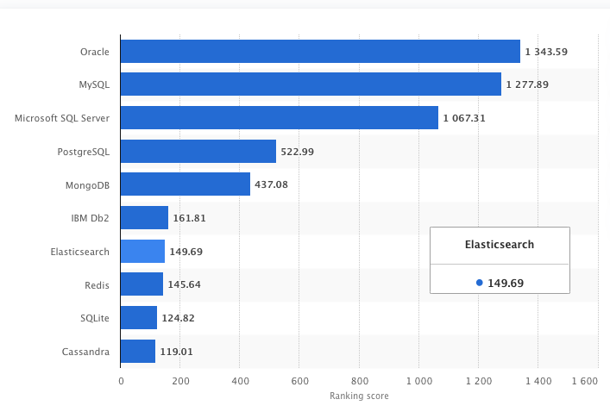
MySQL Seems to not Support the Cool Stuff. PostgreSQL Does.
Why do I use MySQL?
Oracle is not free.
MySQL is free and very commonly used. So, you gain experience.
SQL Server
Did not have free versions in the past but does now.
Usage is still very Windows centric despite Linux support.
PostgreSQL:
Is growing relative to others.
Is what the “cool kids” used.
I have up on being a cool kid in high school.
27 | W4111_02_F20: Introduction to Databases – Lecture 6

Slide 28
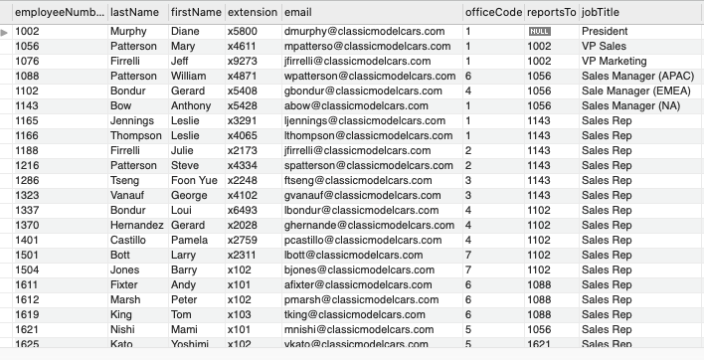
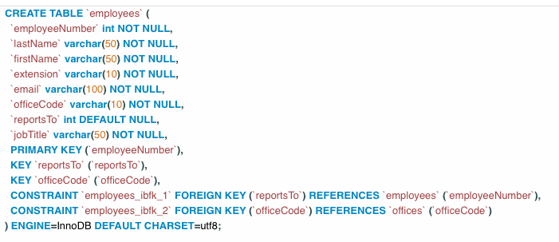
Recursive Queries – Consider classicmodels.employee
There is a reportsTo attribute. There are some interesting aspects:
There is a foreign key constraint from employee.reportsTo → employee.employeNumber.
reportsTo can be NULL.
This may be the first time we have seen these two aspects of foreign keys, but they are common and possible.
Consider the reportsTo chain. How do we compute:
(employee, manager)
(employee, manager, manager’s manager)
... ...
28 | W4111_02_F20: Introduction to Databases – Lecture 6

Slide 29
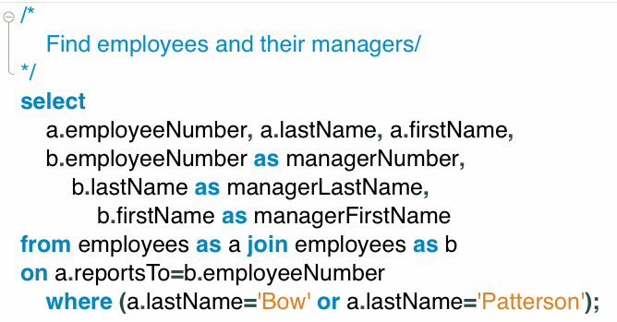
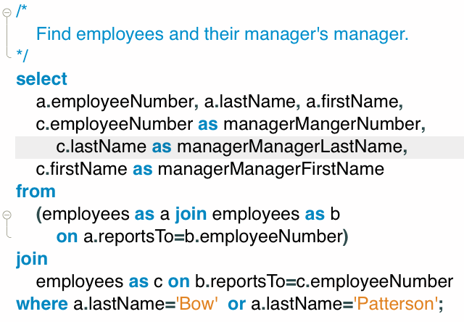
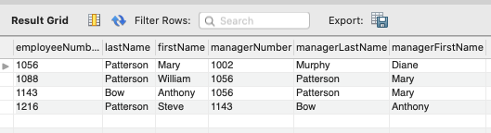
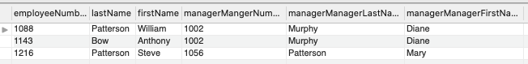
Recursive Queries – Consider classicmodels.employee
Two comments:
This JOIN ... JOIN ... JOIN things is going to get “old real fast.”
29 | W4111_02_F20: Introduction to Databases – Lecture 6

Slide 30
Recursive Queries – Consider classicmodels.employee
We does the manager’s table have four rows but the manager’s manager table has only 3?
Two comments:
This JOIN ... JOIN ... JOIN things is going to get “old real fast.”
30 | W4111_02_F20: Introduction to Databases – Lecture 6

Slide 31
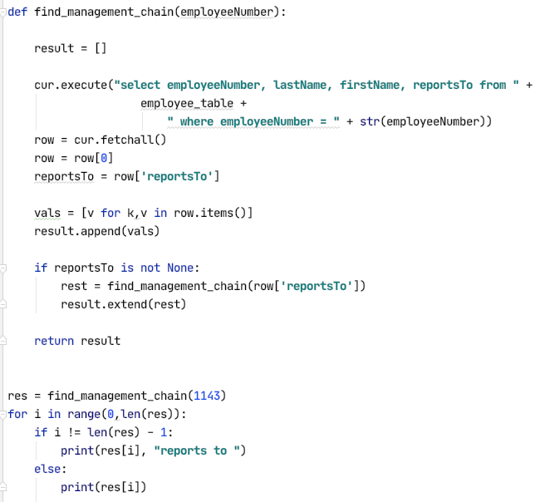
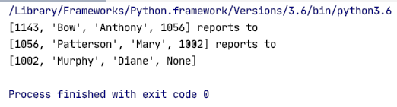
Recursive Queries – Consider classicmodels.employee
There are a couple of ways to solve this problem in a programming language:
Recursion
For Loop
Since SQL is declarative, For Loop is not an option.
SQL does support recursion.
An example of recursion is Fibonacci Numbers:
Fib(n) = {Fib(n-2) + Fib(n-2), Fib(0) = 0, Fib(1) = 1}
0, 1, 1, 2, 3, 5, 8, 13, 21, ... ...
SQL supports recursive queries, but this also falls into the category of “SQL stuff that creeps Grandpa Ferguson out.”
31 | W4111_02_F20: Introduction to Databases – Lecture 6

Slide 32
Recursive Queries

Slide 33
Recursion in SQL
SQL:1999 permits recursive view definition
Example: find which courses are a prerequisite, whether directly or indirectly, for a specific course with recursive rec_prereq(course_id, prereq_id) as ( select course_id, prereq_id from prereq union select rec_prereq.course_id, prereq.prereq_id, from rec_rereq, prereq where rec_prereq.prereq_id = prereq.course_id ) select ∗ from rec_prereq;
This example view, rec_prereq, is called the transitive closure of the prereq relation

Slide 34
The Power of Recursion
Recursive views make it possible to write queries, such as transitive closure queries, that cannot be written without recursion or iteration.
Intuition: Without recursion, a non-recursive non-iterative program can perform only a fixed number of joins of prereq with itself
This can give only a fixed number of levels of managers
Given a fixed non-recursive query, we can construct a database with a greater number of levels of prerequisites on which the query will not work
Alternative: write a procedure to iterate as many times as required
See procedure findAllPrereqs in book

Slide 35
The Power of Recursion
Computing transitive closure using iteration, adding successive tuples to rec_prereq
The next slide shows a prereq relation
Each step of the iterative process constructs an extended version of rec_prereq from its recursive definition.
The final result is called the fixed point of the recursive view definition.
Recursive views are required to be monotonic. That is, if we add tuples to prereq the view rec_prereq contains all of the tuples it contained before, plus possibly more

Slide 36
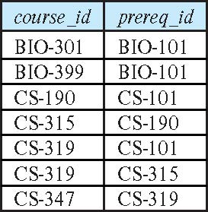
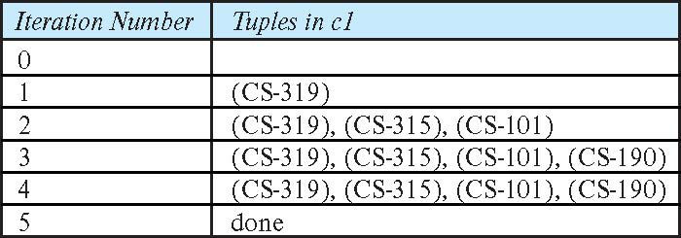
Example of Fixed-Point Computation

Slide 37
Indexes
37 | W4111_02_F20: Introduction to Databases -- Lecture 6

Slide 38
Index Creation
Many queries reference only a small proportion of the records in a table.
It is inefficient for the system to read every record to find a record with particular value
An index on an attribute of a relation is a data structure that allows the database system to find those tuples in the relation that have a specified value for that attribute efficiently, without scanning through all the tuples of the relation.
We create an index with the create index command
create index <name> on <relation-name> (attribute);

Slide 39
Index Creation Example
create table student (ID varchar (5), name varchar (20) not null, dept_name varchar (20), tot_cred numeric (3,0) default 0, primary key (ID))
create index studentID_index on student(ID)
The query:
select * from student where ID = '12345'
can be executed by using the index to find the required record, without looking at all records of student

Slide 40
Functions, Procedures, Triggers
40 | W4111_02_F20: Introduction to Databases -- Lecture 6

Slide 41
Functions and Procedures

Slide 42
Functions and Procedures
Functions and procedures allow “business logic” to be stored in the database and executed from SQL statements.
These can be defined either by the procedural component of SQL or by an external programming language such as Java, C, or C++.
The syntax we present here is defined by the SQL standard.
Most databases implement nonstandard versions of this syntax.
Databases calling out of the DBMS runtime into external programs creeps Grandpa Ferguson out.
External programs are often error prone or fail and this degrades the DB integrity and performance.

Slide 43
Declaring SQL Functions
Define a function that, given the name of a department, returns the count of the number of instructors in that department.
create function dept_count (dept_name varchar(20)) returns integer begin declare d_count integer; select count (* ) into d_count from instructor where instructor.dept_name = dept_name return d_count; end
The function dept_count can be used to find the department names and budget of all departments with more that 12 instructors.
select dept_name, budget from department where dept_count (dept_name ) > 12

Slide 44
Table Functions
The SQL standard supports functions that can return tables as results; such functions are called table functions
Example: Return all instructors in a given department
create function instructor_of (dept_name char(20))
returns table (
ID varchar(5), name varchar(20), dept_name varchar(20), salary numeric(8,2))
return table (select ID, name, dept_name, salary from instructor where instructor.dept_name = instructor_of.dept_name)
Usage
select * from table (instructor_of ('Music'))

Slide 45
SQL Procedures
The dept_count function could instead be written as procedure:
create procedure dept_count_proc (in dept_name varchar(20), out d_count integer) begin
select count(*) into d_count from instructor where instructor.dept_name = dept_count_proc.dept_name
end
The keywords in and out are parameters that are expected to have values assigned to them and parameters whose values are set in the procedure in order to return results.
Procedures can be invoked either from an SQL procedure or from embedded SQL, using the call statement.
declare d_count integer; call dept_count_proc( 'Physics', d_count);

Slide 46
SQL Procedures (Cont.)
Procedures and functions can be invoked also from dynamic SQL
SQL allows more than one procedure of the so long as the number of arguments of the procedures with the same name is different.
The name, along with the number of arguments, is used to identify the procedure.

Slide 47
Language Constructs for Procedures & Functions
SQL supports constructs that gives it almost all the power of a general-purpose programming language.
Warning: most database systems implement their own variant of the standard syntax below.
Compound statement: begin … end,
May contain multiple SQL statements between begin and end.
Local variables can be declared within a compound statements
While and repeat statements:
while boolean expression do
sequence of statements ;
end while
repeat
sequence of statements ;
until boolean expression
end repeat

Slide 48
Language Constructs (Cont.)
For loop
Permits iteration over all results of a query
Example: Find the budget of all departments declare n integer default 0; for r as select budget from department where dept_name = 'Music' do set n = n + r.budget end for

Slide 49
Language Constructs – if-then-else
Conditional statements (if-then-else)
if boolean expression then statement or compound statement elseif boolean expression then statement or compound statement else statement or compound statement end if

Slide 50
Example procedure
Registers student after ensuring classroom capacity is not exceeded
Returns 0 on success and -1 if capacity is exceeded
See book (page 202) for details
Signaling of exception conditions, and declaring handlers for exceptions
declare out_of_classroom_seats condition declare exit handler for out_of_classroom_seats begin … end
The statements between the begin and the end can raise an exception by executing “signal out_of_classroom_seats”
The handler says that if the condition arises he action to be taken is to exit the enclosing the begin end statement.

Slide 51
External Language Routines
SQL allows us to define functions in a programming language such as Java, C#, C or C++.
Can be more efficient than functions defined in SQL, and computations that cannot be carried out in SQL\can be executed by these functions.
Declaring external language procedures and functions
create procedure dept_count_proc(in dept_name varchar(20), out count integer) language C external name '/usr/avi/bin/dept_count_proc' create function dept_count(dept_name varchar(20)) returns integer language C external name '/usr/avi/bin/dept_count'

Slide 52
External Language Routines (Cont.)
Benefits of external language functions/procedures:
more efficient for many operations, and more expressive power.
Drawbacks
Code to implement function may need to be loaded into database system and executed in the database system’s address space.
risk of accidental corruption of database structures
security risk, allowing users access to unauthorized data
There are alternatives, which give good security at the cost of potentially worse performance.
Direct execution in the database system’s space is used when efficiency is more important than security.

Slide 53
Security with External Language Routines
To deal with security problems, we can do on of the following:
Use sandbox techniques
That is, use a safe language like Java, which cannot be used to access/damage other parts of the database code.
Run external language functions/procedures in a separate process, with no access to the database process’ memory.
Parameters and results communicated via inter-process communication
Both have performance overheads
Many database systems support both above approaches as well as direct executing in database system address space.

Slide 54
Triggers

Slide 55
Triggers
A trigger is a statement that is executed automatically by the system as a side effect of a modification to the database.
To design a trigger mechanism, we must:
Specify the conditions under which the trigger is to be executed.
Specify the actions to be taken when the trigger executes.
Triggers introduced to SQL standard in SQL:1999, but supported even earlier using non-standard syntax by most databases.
Syntax illustrated here may not work exactly on your database system; check the system manuals
INSERT
UPDATE
DELETE

Slide 56
Triggering Events and Actions in SQL
Triggering event can be insert, delete or update
Triggers on update can be restricted to specific attributes
For example, after update of takes on grade
Values of attributes before and after an update can be referenced
referencing old row as : for deletes and updates
referencing new row as : for inserts and updates
Triggers can be activated before an event, which can serve as extra constraints. For example, convert blank grades to null.
create trigger setnull_trigger before update of takes referencing new row as nrow for each row when (nrow.grade = ' ') begin atomic set nrow.grade = null; end;

Slide 57
Trigger to Maintain credits_earned value
create trigger credits_earned after update of takes on (grade) referencing new row as nrow referencing old row as orow for each row when nrow.grade <> 'F' and nrow.grade is not null and (orow.grade = 'F' or orow.grade is null) begin atomic update student set tot_cred= tot_cred + (select credits from course where course.course_id= nrow.course_id) where student.id = nrow.id; end;

Slide 58
Statement Level Triggers
Instead of executing a separate action for each affected row, a single action can be executed for all rows affected by a transaction
Use for each statement instead of for each row
Use referencing old table or referencing new table to refer to temporary tables (called transition tables) containing the affected rows
Can be more efficient when dealing with SQL statements that update a large number of rows

Slide 59
When Not To Use Triggers
Triggers were used earlier for tasks such as
Maintaining summary data (e.g., total salary of each department)
Replicating databases by recording changes to special relations (called change or delta relations) and having a separate process that applies the changes over to a replica
There are better ways of doing these now:
Databases today provide built in materialized view facilities to maintain summary data
Databases provide built-in support for replication
Encapsulation facilities can be used instead of triggers in many cases
Define methods to update fields
Carry out actions as part of the update methods instead of through a trigger

Slide 60
When Not To Use Triggers (Cont.)
Risk of unintended execution of triggers, for example, when
Loading data from a backup copy
Replicating updates at a remote site
Trigger execution can be disabled before such actions.
Other risks with triggers:
Error leading to failure of critical transactions that set off the trigger
Cascading execution

Slide 61
Authorization
61 | W4111_02_F20: Introduction to Databases -- Lecture 6

Slide 62
Authorization
We may assign a user several forms of authorizations on parts of the database.
Read - allows reading, but not modification of data.
Insert - allows insertion of new data, but not modification of existing data.
Update - allows modification, but not deletion of data.
Delete - allows deletion of data.
Each of these types of authorizations is called a privilege. We may authorize the user all, none, or a combination of these types of privileges on specified parts of a database, such as a relation or a view.
Security terms:
Authentication – User ID, Password; newuser, dbuserdbuser; Connection
Authorization – Permission to do something? “Rule”
Privacy
Many, many more ... ...

Slide 63
Security terms:
Authentication – User ID, Password; newuser, dbuserdbuser; Connection
Authorization – Permission to do something? “Rule” A specific rule allows a user based on
Identity (Who)
Operation/Verb (INSERT, DELETE, UPDATE, SELECT)
Object: Schema, Schema.Table
Who:
Specific User
Role
Allow User to be in a role (group of users)
Concept:
That which is not prohibited is allowed.
That which is not EXPLICITLY ALLOWED is denied.

Slide 64
Authorization (Cont.)
Forms of authorization to modify the database schema
Index - allows creation and deletion of indices.
Resources - allows creation of new relations.
Alteration - allows addition or deletion of attributes in a relation.
Drop - allows deletion of relations.

Slide 65
Authorization Specification in SQL
The grant statement is used to confer authorization
grant <privilege list> on <relation or view > to <user list>
<user list> is:
a user-id
public, which allows all valid users the privilege granted
A role (more on this later)
Example:
grant select on department to Amit, Satoshi
Granting a privilege on a view does not imply granting any privileges on the underlying relations.
The grantor of the privilege must already hold the privilege on the specified item (or be the database administrator).

Slide 66
Privileges in SQL
select: allows read access to relation, or the ability to query using the view
Example: grant users U₁, U₂, and U₃ select authorization on the instructor relation:
grant select on instructor to U₁, U₂, U₃
insert: the ability to insert tuples
update: the ability to update using the SQL update statement
delete: the ability to delete tuples.
all privileges: used as a short form for all the allowable privileges

Slide 67
Revoking Authorization in SQL
The revoke statement is used to revoke authorization.
revoke <privilege list> on <relation or view> from <user list>
Example:
revoke select on student from U₁, U₂, U₃
<privilege-list> may be all to revoke all privileges the revokee may hold.
If <revokee-list> includes public, all users lose the privilege except those granted it explicitly.
If the same privilege was granted twice to the same user by different grantees, the user may retain the privilege after the revocation.
All privileges that depend on the privilege being revoked are also revoked.

Slide 68
Roles
A role is a way to distinguish among various users as far as what these users can access/update in the database.
To create a role we use:
create a role <name>
Example:
create role instructor
Once a role is created we can assign “users” to the role using:
grant <role> to <users>

Slide 69
Roles Example
create role instructor;
grant instructor to Amit;
Privileges can be granted to roles:
grant select on takes to instructor;
Roles can be granted to users, as well as to other roles
create role teaching_assistant
grant teaching_assistant to instructor;
Instructor inherits all privileges of teaching_assistant
Chain of roles
create role dean;
grant instructor to dean;
grant dean to Satoshi;

Slide 70
Authorization on Views
create view geo_instructor as (select * from instructor where dept_name = 'Geology');
grant select on geo_instructor to geo_staff
Suppose that a geo_staff member issues
select * from geo_instructor;
What if
geo_staff does not have permissions on instructor?
Creator of view did not have some permissions on instructor?

Slide 71
Other Authorization Features
references privilege to create foreign key
grant reference (dept_name) on department to Mariano;
Why is this required?
transfer of privileges
grant select on department to Amit with grant option;
revoke select on department from Amit, Satoshi cascade;
revoke select on department from Amit, Satoshi restrict;
And more!

Slide 72
Entity-Relationship Model (Continued)
72 | W4111_02_F20: Introduction to Databases -- Lecture 6

Slide 73
Weak Entity Sets
73 | W4111_02_F20: Introduction to Databases -- Lecture 6

Slide 74
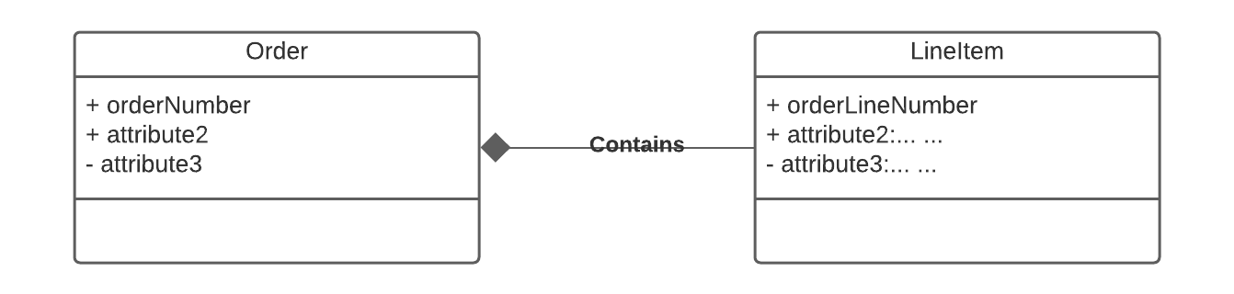
Example Order Form – Order “Contains” Line Items
Customer ID: 201
OrderNo: 31
OrderedDate:504
Containment is a common concept in data models.
Containment implementation is common in object-oriented models.
Domains are atomic in the relational model → Lists/Arrays are not possible.
Weak Entity is one way to model.
ProductID | Quantity | Price | OrderID
111 | 2 | 2.10 | 31
101 | 11 | 1.30 | 31
333 | 102 | 47.5 | 31
public class LineItem { }
public class Order { LineItem lineItem[]; }
74 | W4111_02_F20: Introduction to Databases – Lecture 6

Slide 75
Weak Entity Sets
Consider a section entity, which is uniquely identified by a course_id, semester, year, and sec_id.
Clearly, section entities are related to course entities. Suppose we create a relationship set sec_course between entity sets section and course.
Note that the information in sec_course is redundant, since section already has an attribute course_id, which identifies the course with which the section is related.
One option to deal with this redundancy is to get rid of the relationship sec_course; however, by doing so the relationship between section and course becomes implicit in an attribute, which is not desirable.

Slide 76
Weak Entity Sets (Cont.)
An alternative way to deal with this redundancy is to not store the attribute course_id in the section entity and to only store the remaining attributes section_id, year, and semester.
However, the entity set section then does not have enough attributes to identify a particular section entity uniquely
To deal with this problem, we treat the relationship sec_course as a special relationship that provides extra information, in this case, the course_id, required to identify section entities uniquely.
A weak entity set is one whose existence is dependent on another entity, called its identifying entity
Instead of associating a primary key with a weak entity, we use the identifying entity, along with extra attributes called discriminator to uniquely identify a weak entity.

Slide 77
Weak Entity Sets (Cont.)
An entity set that is not a weak entity set is termed a strong entity set.
Every weak entity must be associated with an identifying entity; that is, the weak entity set is said to be existence dependent on the identifying entity set.
The identifying entity set is said to own the weak entity set that it identifies.
The relationship associating the weak entity set with the identifying entity set is called the identifying relationship.
Note that the relational schema we eventually create from the entity set section does have the attribute course_id, for reasons that will become clear later, even though we have dropped the attribute course_id from the entity set section.

Slide 78
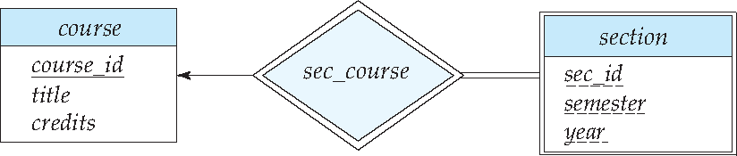
Expressing Weak Entity Sets
In E-R diagrams, a weak entity set is depicted via a double rectangle.
We underline the discriminator of a weak entity set with a dashed line.
The relationship set connecting the weak entity set to the identifying strong entity set is depicted by a double diamond.
Primary key for section – (course_id, sec_id, semester, year)

Slide 79
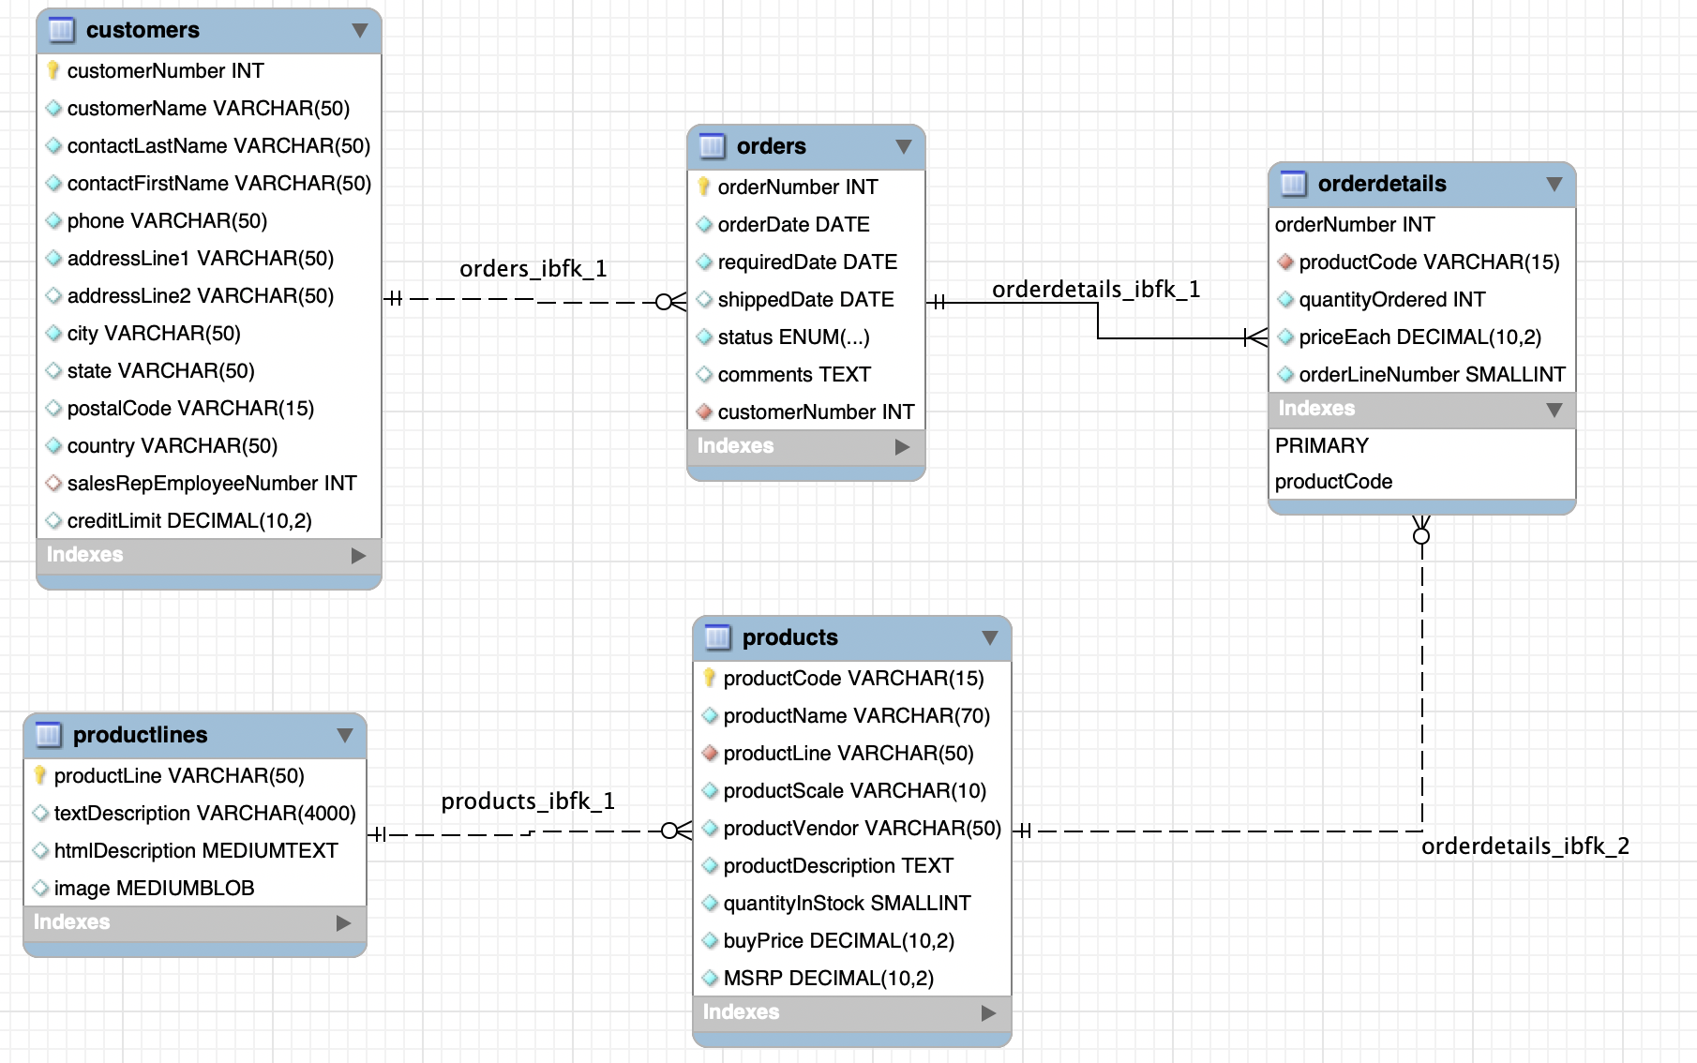
Weak Entity Example: Orders, OrderDetails
https://www.mysqltutorial.org/mysql-sample-database.aspx/
79 | W4111_02_F20: Introduction to Databases – Lecture 6

Slide 80
Inheritance, IsA, Specialization
80 | W4111_02_F20: Introduction to Databases -- Lecture 6

Slide 81
Specialization
Top-down design process; we designate sub-groupings within an entity set that are distinctive from other entities in the set.
These sub-groupings become lower-level entity sets that have attributes or participate in relationships that do not apply to the higher-level entity set.
Depicted by a triangle component labeled ISA (e.g., instructor “is a” person).
Attribute inheritance – a lower-level entity set inherits all the attributes and relationship participation of the higher-level entity set to which it is linked.

Slide 82
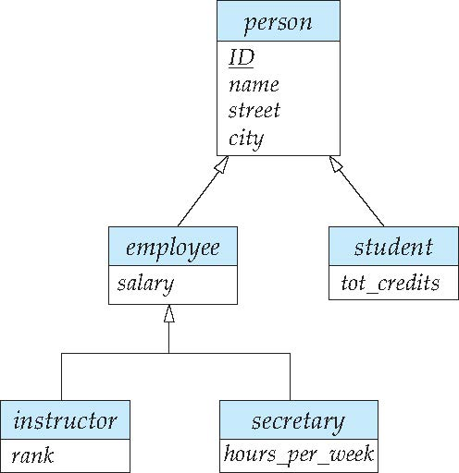
Specialization Example
Overlapping – employee and student
Disjoint – instructor and secretary
Total and partial

Slide 83
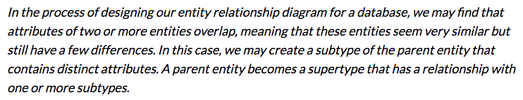
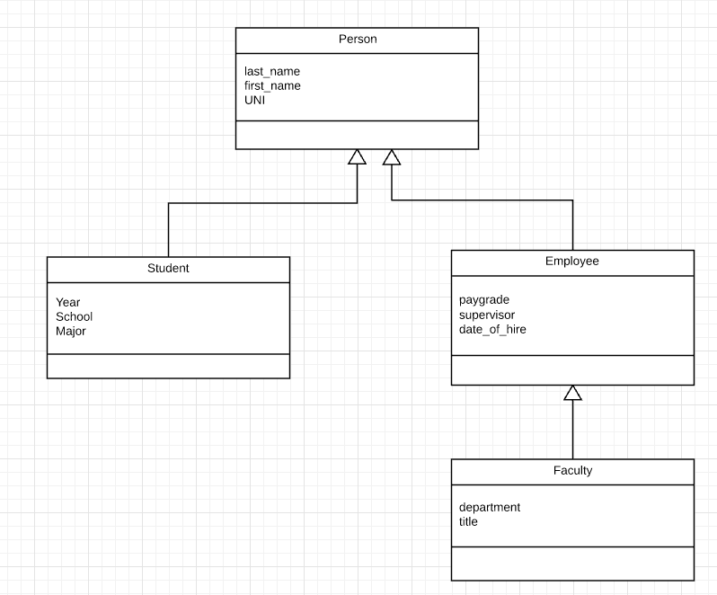
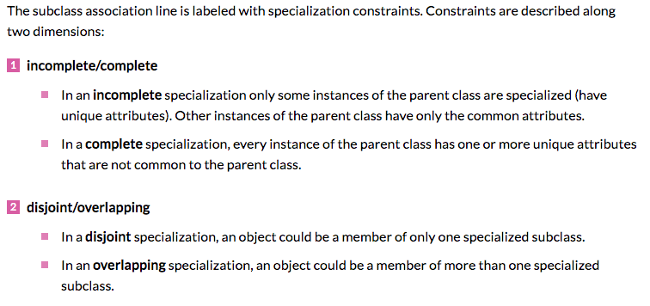
Inheritance, IsA, Specialization
Are all employees faculty?
Can students also be employees?
http://www.vertabelo.com/blog/technical-articles/inheritance-in-a-relational-database
83 | W4111_02_F20: Introduction to Databases – Lecture 6

Slide 84
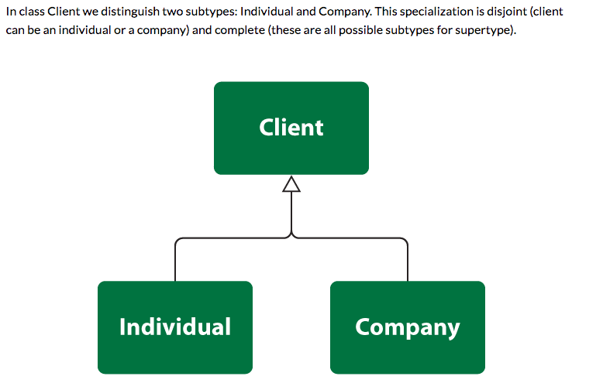
Simpler Example
84 | W4111_02_F20: Introduction to Databases – Lecture 6

Slide 85
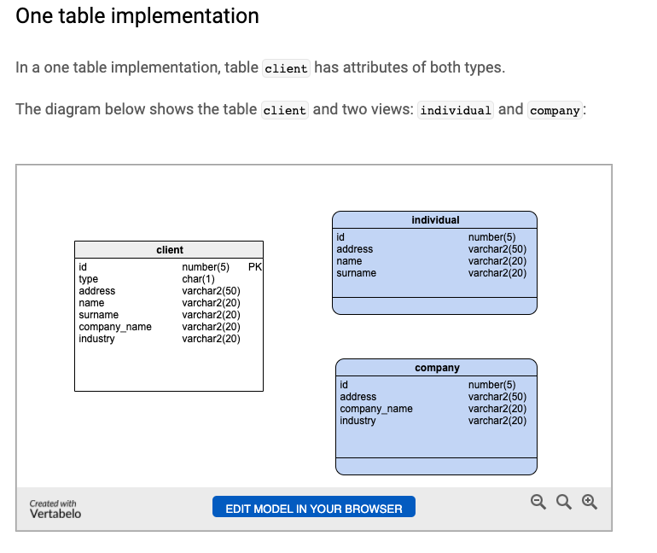
One Table Implementation
Views
Tables
85 | W4111_02_F20: Introduction to Databases – Lecture 6

Slide 86
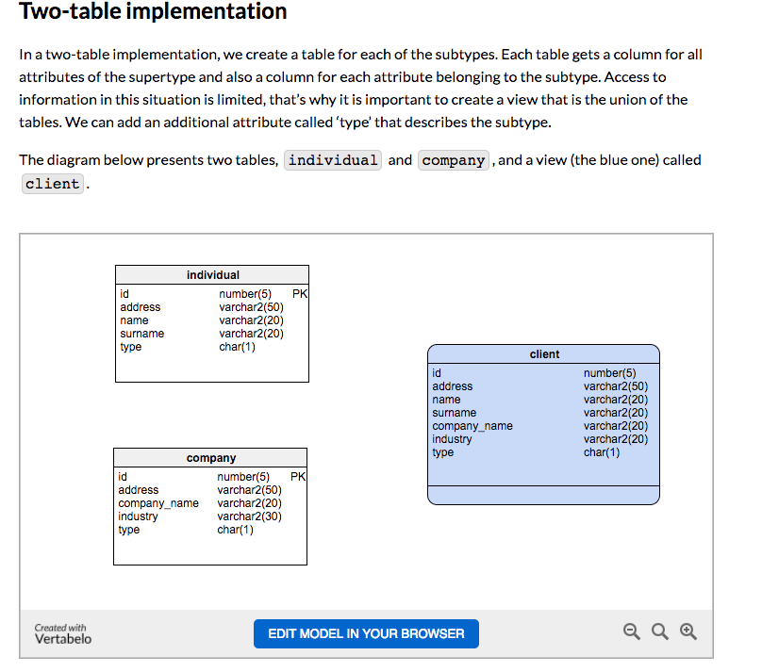
Two Table Implementation
View
Tables
86 | W4111_02_F20: Introduction to Databases – Lecture 6

Slide 87
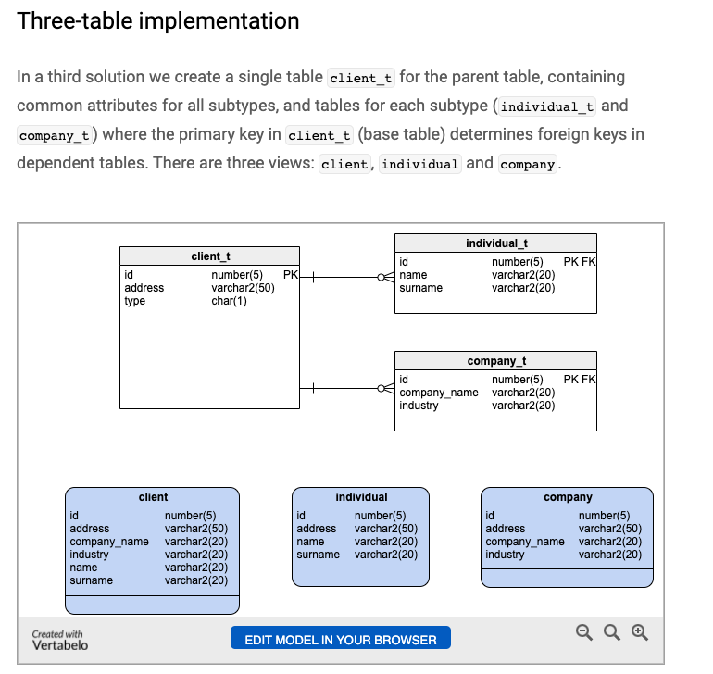
Two Table Implementation
Tables
Views
87 | W4111_02_F20: Introduction to Databases – Lecture 6

Slide 88
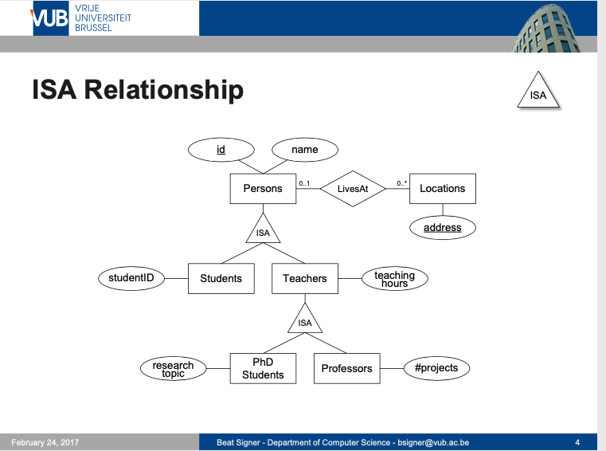
Modeling
88 | W4111_02_F20: Introduction to Databases – Lecture 6

Slide 89
ER vs. UML Class Diagrams
ER Diagram Notation
Equivalent in UML
I use this approach in Crow’s Foot Notation but that is not standard.
* Generalization can use merged or separate arrows independent
of disjoint/overlapping

Slide 90
Let’s Do Some Worked Examples
90 | W4111_02_F20: Introduction to Databases -- Lecture 5

Slide 91
Redundant Attributes
91 | W4111_02_F20: Introduction to Databases -- Lecture 6

Slide 92
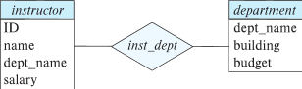
Redundant Attributes
Suppose we have entity sets:
instructor, with attributes: ID, name, dept_name, salary
department, with attributes: dept_name, building, budget
We model the fact that each instructor has an associated department using a relationship set inst_dept
The attribute dept_name in instructor replicates information present in the relationship and is therefore redundant
and needs to be removed.
BUT: when converting back to tables, in some cases the attribute gets reintroduced, as we will see later.

Slide 93
Design Alternatives
In designing a database schema, we must ensure that we avoid two major pitfalls:
Redundancy: a bad design may result in repeat information.
Redundant representation of information may lead to data inconsistency among the various copies of information
Incompleteness: a bad design may make certain aspects of the enterprise difficult or impossible to model.
Avoiding bad designs is not enough. There may be a large number of good designs from which we must choose.
Emphasis Added
Notes:
93

Slide 94
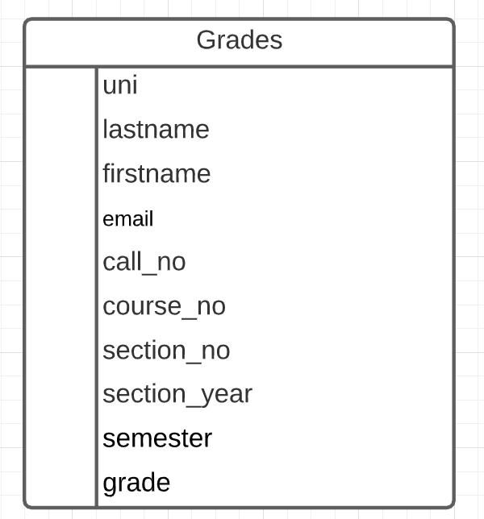
Redundant Information Example
Consider the Grades table/relation:
Uni identifies student.
lastname, firstname, email have obvious meaning.
call_no, course_no, section_no, semester, section_year, grade have the obvious meanings relative to Columbia course info.
Let’s focus on redundant information problems:
Inside the table:
(uni, lastname, firstname, email)
(call_no, course_no, section_no, section_year, semester)
Between tables: Presumable there are other tables with information on
Course descriptions and sections.
Course enrollments.
Additional student information.
This is easier if we make some data and show how we can “break it.”
94 | W4111_02_F20: Introduction to Databases – Lecture 6

Slide 95
“Inheritance”
95 | W4111_02_F20: Introduction to Databases -- Lecture 5

Slide 96
Inheritance – Putting Some Pieces Together
We will
Model Person, Faculty, Student.
Implement using a two-table solution.
Use a function to generate UNIs.
Integrity
Use
View
Constraints
Security
Stored Procedure
Triggers
To implement integrity.
96 | W4111_02_F20: Introduction to Databases – Lecture 6

